Slide 1
Final Briefing: 8th BDM 102K Ultra Marathon Race (January 30-31, 2016)
Rules & Regulations; Reminders; and Instructions

Slide 2
Executive Rule Summary
No “whining”
No Littering
THINK SAFETY ALWAYS
Observe GMRC
If you “fucked-up”, don’t blame the RD. Blame yourself!
“Ceremonial HUG” with the RD after Crossing The Finish Line
Awarding @ The Finish Line

Slide 3
Integrity of the Race
Acts of “cheating” will eventually come out.
Everybody is “deputized” to strictly report infractions of this rule.
Remember that you applied for this race to commemorate and honor our fallen heroes.
DNF is more honorable than cheating in the race.

Slide 4
Support Vehicle
Must be a 4-wheeled vehicle
1-3 Runners For Every Support Vehicle.
MUST “leapfrog” the runner at all times. No “shadowing” of any runner
Parking should be off the National Highway.
Properly marked with BDM 102 Tarpaulin. (Don’t remove it from the vehicle)
Remember: BDM Km Post #7 (Drop Off @ Km 00 & Proceed to Km #7)

Slide 5
Support Vehicle
No Support Vehicle Will Be Allowed To Park Across The Street In Front Of The BDM Km #00 Shrine (Starting Area)
Support Vehicles Shall Drop-Off Their Runner & Immediately Proceed To BDM Km Post #6 or #7 To Wait For Their Runner

Slide 6
Support Vehicle: “Leap-Frog” & “Shadowing”
“Leap-Frogging”: Support Vehicle Must Be Always Parked At A Distance Ahead Of The Runner
“Shadowing”: Support Vehicle Is Either Ahead or Following The Runner With The Same Speed As The Runner’s.
Support Vehicles Should ALWAYS Park On The Right Far Edge of the Shoulder.

Slide 7
Support Vehicle
NO Runner shall be allowed to approach, enter & stay inside the Support Vehicle during the Race.
Support Vehicles’ Data shall be Registered To The RD’s Staff. Brand, Model, Color, & Plate Number Shall Be Submitted In Writing.
RD & Staff shall not accept any Baggage or Drop Bag from any Runner

Slide 8
Running On Single File
On the left side (farthest) of the road’s shoulder, facing traffic!
No Running Together Abreast
No walking sticks or trekking poles
No “cooling vests”
No umbrellas

Slide 9
Headphones
No MP3s & Headphones will be allowed during the race

Slide 10
Pacer
Pacer is NOT allowed during the race.
BANDITS are not allowed during the Race

Slide 11
Medical Certificate
All qualified runners must submit their Medical Certificate taken at least 2 months before Race Day
Doctor’s Certificate will suffice stating the runner is healthy to be exposed in strenuous activities.
Last Day of Submission: TODAY
No Medical Certificate, No Run

Slide 12
Waiver
Every Runner Must Sign “The Assumption Of Risk & Statement of Waiver”
NO Submission/Signature, NO Run!

Slide 13
Display of Banners/Tarps
No display of Corporate Sponsors’ Tarps on Runner’s Support Vehicle.
Will allow display of Running Club’s/Group’s tarps only.
Logos of Runners’ Sponsors are limited on their uniform/apparel

Slide 14
BDM LOGO
Nobody is allowed to use the BDM Logo in any manner during the race.
No BDM Logo on Shirts or Apparel Displayed By Runners and/or Support Crew (Except Shirts From Race Organizer)

Slide 15
Running For Charity
Running For Charity is not allowed without the Permission of the Race Director

Slide 16
Support Crew
Each runner must have a support crew.
Support = giving/handing anything that the runner needs.
Support Crew Are Required to Approach Their Runner.
Support Crew should maintain cleanliness on places where they park. Maintain garbage bags in their support vehicle.
Always be vigilant in crossing the highway.

Slide 17
Support Crew
Instance When Runners Have To Approach/Stay Near The Parked Support Vehicle
  To Eat/Attend To Personal Care/Massage
  @ BDM Km Post #50 (Abucay, Bataan)
Immediately Cross The Road & Continue Running On The Left Side of the Road After The “Pit Stop” @ BDM Km Post #50

Slide 18
Cut-Off Time
Cut-Off Time @ BDM Km Post #50: 9 Hours
Cut-Off Time @ Finish Line: 18 Hours
Finishers Beyond the 18-Hour Cut-Off time will be declared as Did Not Finish (DNF)

Slide 19
Declaration Of DNF
Steps In Declaring DNF During The Event:
  Contact The Following CP Numbers: 0918-910-0825; 0918-965-9895 & 0915-753-3834
  State Your Name; Bib Number & the Reason Why You Are Declaring Yourself As DNF
  State If You Need Immediate Medical Attention/Evacuation
  State Your Present Location Relative to the Nearest BDM Kilometer Post
  Remove Race Bib & Proceed To The Finish Line

Slide 20
Race Bib/Number
Always Be Visible (on the front)
Race bib should be pinned in front of his/her running shirt or shorts
If runner is using race bib belt, make sure the bib stays in front of the body.
Memorize your Race Bib Number

Slide 21
Media Broadcast & Coverage
No Media Broadcast & Coverage will be allowed without the permission of the Race Organizer/Race Director.
NO Official Photography and Film Documentation For The Race.
Photographers Who Are Covering The Event Shall Provide CD Copy of the Pictures of the Race

Slide 22
Leaving The Course
Runners are no longer allowed to leave the race course to eat in commercial establishments.
Support crew will be utilized to run errands for the runner/s

Slide 23
Safety Gadgets & First Aid Kits
Each runner must have a “reflectorized” vest; flashlight/headlight; and extra batteries.
Runners are advised to bring their own First Aid Kit just in case of any emergency during the race
Safety Gadgets/Accessories are Mandatory during the Night Run

Slide 24
Starting Area/Line Procedure
Check-In & Sign Waiver With BR’s Staff
Change To Running Attire Immediately
Send Your Support Vehicle To The BDM Km Post #6 or #7
Stay Inside the BDM Shrine For The Briefing & Short Program & Photo-Ops

Slide 25
Finish Line Area
NO Support Vehicle will be allowed to Enter & Park at the Road leading to the Old Railway Station (BDM Km Post #102)
Support Vehicles Should Park On The Highway In front of the Provincial Capitol
Support Vehicles Which Insist To Enter & Park On The Road Will Have Their Runners Declared as DQ’d and DNF

Slide 26
Before & After The Finish Line
No Pacer/Escort Runner Is Allowed With A Runner Approaching The Finish Line
Only Registered Runners Are Allowed To Cross The Finish Line
HUG The RD After Crossing The Finish Line
Awarding of Swags (Medal, Trophy, & Finisher’s Shirt) & Official Photo Shoot Will Follow Immediately

Slide 27
Code of Ethics For Ultrarunners
Honesty
Sharing & Cooperation
Friendship
Obedience/Discipline
Courtesy

Slide 28
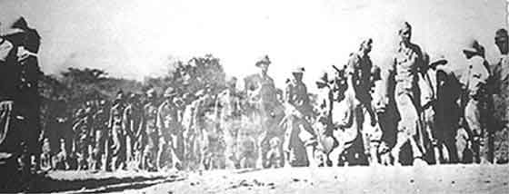
Coordinating Instructions

Slide 29
Coordinating Instructions
Remember the following:
  @ Key Intersections:
  BDM Km #14;
  Km #23;
  Km #32---ALWAYS TURN RIGHT
  Km # 83: Turn Right Towards Guagua, Pampanga & After 20 meters, Turn Left
  @ Guagua, Pampanga: GO Straight to the Market Area; Don’t Follow Detour Route For Vehicles
  Turn Left On An Elevated Bridge (Short) and then Turn Right on the Intersection

Slide 30
Coordinating Instructions
Ambulances & Medical Teams
Emergency Contact Numbers:
  0918-910-0825
  0918-965-9895
  0915-753-3834
In dark places, run in the company of other runner/s
Beware of Dogs; Drunk Individuals; Ladies & Motorists

Slide 31
Final Reminders
Cut-Off Times Will Be Strictly Enforced
NO “Unofficial” Finishers
Race Is CLOSED After 18 Hours
Runners’ Responsibility To Inform Support Crew On The Rules & Regulations
“Listen To Your Body”
“Solve Your Problem/s”
“Stick To Your Training”
DECIDE
P R A Y

Slide 32
Problems???
Chafing
Blisters
Heat Exhaustion
Pain/Fatigue
Cramps
Acid Reflux

Slide 33
Final Reminders
Assembly Time: 9:00 PM, January 30, 2016 (Saturday)
Gun Start: 10:00PM, January 30, 2016
Place: BDM Km Post #00, BDM Shrine, Mariveles, Bataan (Beside Jollibee Mariveles)
Cut-Off Time/End Of Race: 4:00 PM, January 31, 2016
(Bring Your Race Bibs To The Starting Line + Accessories)

Slide 34
Portalets?
Use Convenience Stores & Gasoline Stations Along The Route
Bring “Malong” or “Balikbayan Box”
Be Resourceful & Imaginative
Comfort Rooms @ The Finish Line

Slide 35
Race Marshals?
Pre-Positioned In Key Intersections
Roving Intelligence Personnel
Presence of PAU/BR’s “Volunteers”

Slide 36
Review of BDM 102 Past Results
Time To Beat: 9:11:56 Hours (Overall/Men’s) By Joel Bengtay
Time To Beat: 12:16:29 Hours (Ladies) By Nina Ferando
1st BDM: 63/83 Finishers (75.9%)
2nd BDM: 104/123 Finishers (84.5%)
3rd BDM: 112/154 Finishers (72.7%)
4th BDM: 160/186 Finishers (86 %)
5th BDM: 202/220 Finishers (91.8%)
6th BDM: 253/300 Finishers (84.33%)
7th BDM: 150/165 Finishers (90.9%)
Total of BDM 102 Finishers: 1,044

Slide 37
2015 BDM 102 Information
Finisher’s Medal Categories: (Based From Finish Times)
  GOLD Medal: Sub-13 Hours
  SILVER Medal: Sub-16 Hours
  BRONZE Medal: Sub-18 Hours
  7th BDM 102/2015 Results:
  GOLD---12
  SILVER---53
  BRONZE---85

Slide 38
2016 BDM 102 Information
Number of Registered Runners: 200+
Number of Lady Runners: 20+
2016 BDM 102 & 160 “GET TOGETHER” PARTY PAU Appreciation Night @ The Philippine Army Officers Clubhouse, Philippine Army Headquarters, Taguig City o/a 6:30 PM March 2, 2016 (Wednesday)

Slide 39
Tips
Stick To Your Pace & Training
Nutrition Is The Key. Hydrate & Eat Ahead!
Never Introduce Anything “New” During The Race
Ice/Ice Water & “Sugar” Are Your Friends
#1 Enemy is YOURSELF!
Stay Safe & Have Fun

Slide 40
GOOD LUCK & SEE YOU AT STARTING LINE!!!

Slide 41
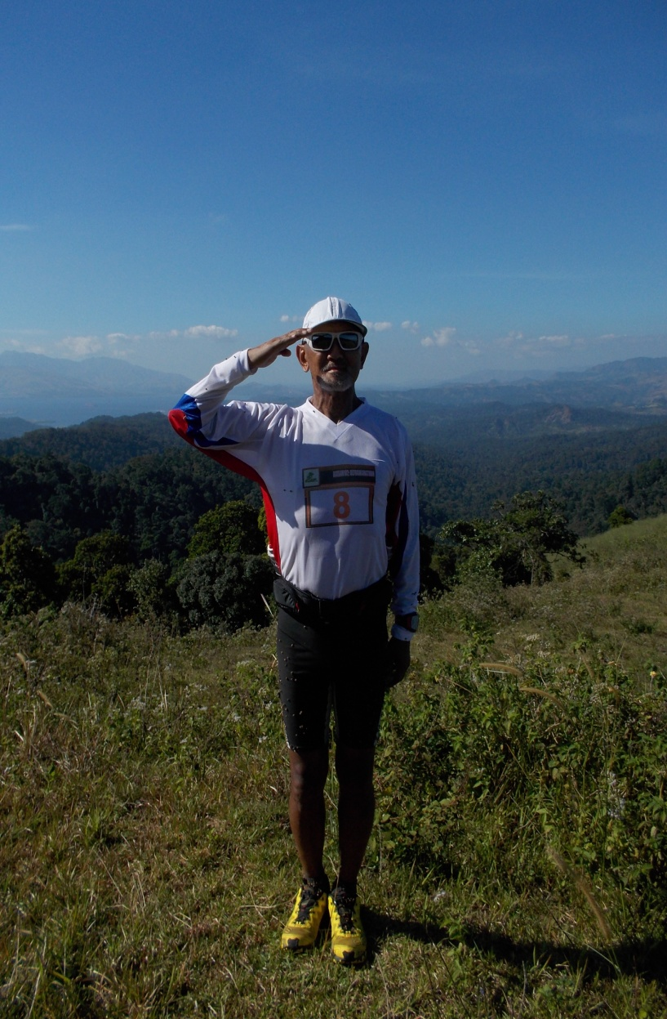
Salute To All The Participants!

