Slide 1
Ultra Marathon
Introduction & Basics

Slide 2
Definition Of Ultra Marathon
Distance More Than 42.195 Kilometers or 26.2 Miles (Marathon Race Distance)
Official Race Entry-Level Distance: 50 Kilometers

Slide 3
How To Get The Title As Ultra Marathoner
Runner Has The Intent To Finish The Distance
Completion Of An Official Ultra Marathon Race/Official Finisher
Integrity

Slide 4
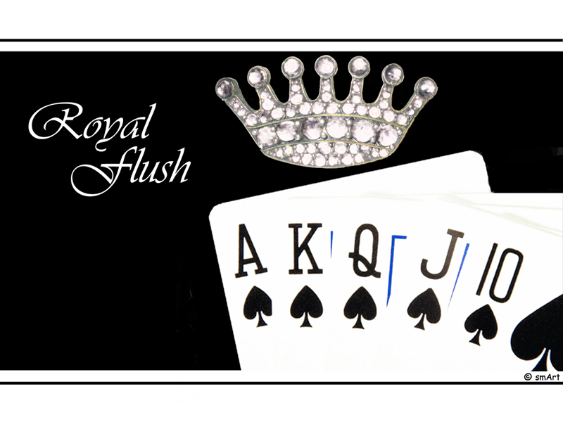
“Royal Flush”

Slide 5
“Ten”
Marathon Finish
Official Marathon Race (42K) Finisher
  Experienced Hitting “The Wall” and Being Able To Overcome It
Progressively Joined Running Events Over A Period Of Time (5K To 42K Races)
Trained For 3-4 Months Leading To A Marathon Race
Periodization: Build-Up Endurance---Speed Training---Tapering---Race---Recovery

Slide 6
“Jack”
Recovery
To Be Observed On A Daily, Monthly, Yearly Basis
After Workout (Hydrate & Replace “Burned” Calories Within 30 Minutes After Run)
“Hard & Easy” Training Days
Training “Block” On Monthly Basis
Seasonal Approach On Ultra Races
  Consider Joining Intermediate Races To Validate Training Towards A Goal Race

Slide 7
“Jack”
Tips For Recovery
Keep hydrated during & after runs.
Refuel immediately after runs.
Sleep 7-8 hours every night.
Take A Nap.
Wear Compression Clothing After Strenuous Runs
Ice Baths After Runs
(Copied From The Book “Relentless Forward Progress” By Bryon Powell)

Slide 8
“Queen”
Consistency
“Run More”
Run At Slower Pace
“10% Rule” As A Guide, Not A Commandment (In Increasing Weekly/Monthly Mileage)
Weekends: Long Runs & Back-to-Back (B2B) Long Runs
Long Run For A 50K Race = 40 Kilometers
Long Run For A 50-Mile Race = 48 Kilometers

Slide 9
“King”
Specificity Of Training
Research/Recon On The Course
Road Ultras = Road Runs
Trail Ultras = Mountain Trails
Train In A Place That “Mimics” The Race Course
Focus On Testing One’s Gears, Nutrition, & Fitness
Acclimatize

Slide 10
“Ace”
Nutrition & Hydration
Fuel Your Body
Experiment & Always Be Proactive. Don’t Wait Till Your Are Thirsty or Hungry
Never Introduce Something New On Race Day. Stick To Your Nutrition/Hydration Strategy During Training
Experience Is The Best Teacher

Slide 11
What To Expect In Ultra Races
Simplicity
It’s Not About The Form, But More On The Substance
Challenge One’s Capabilities
GMRC (Good Manners & Right Conduct)
“No Whining”
Friendship, Camaraderie, Cooperation, Unity
Extended Goals

Slide 12
Thank You & Have Fun!

