Slide 1
Rules & Regulations
3rd BDM 102K Ultra Marathon Race & 1st BDM 160K Ultra Marathon Race
February 26-27 & March 5-6, 2011

Slide 2
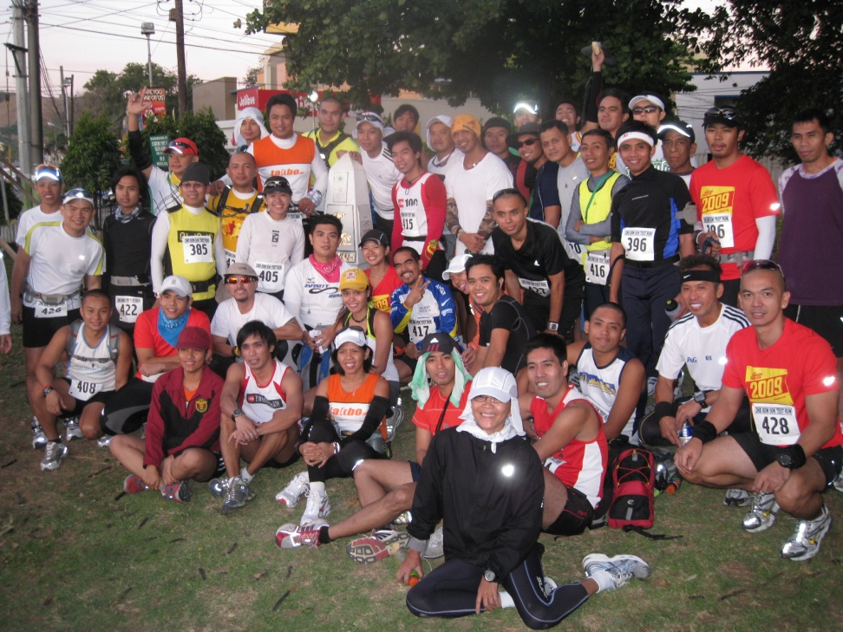
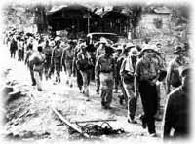
Then & Now

Slide 3
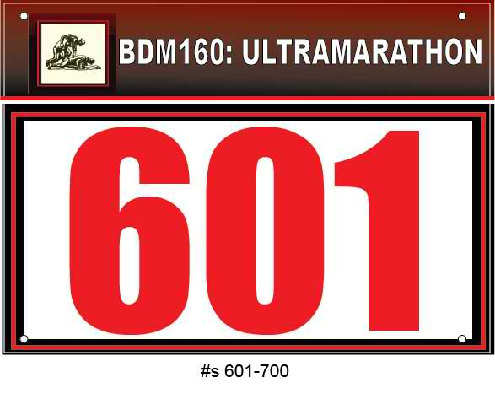
2011: Special Feature

Slide 4
Introduction: WHY?
Commemorate an Event In Our History
“Bragging Rights” & Reference Purposes
Earn the Title as an “Ultra Runner”
Lifetime Experience in Running (Publish A Book/Memoir In Running)
More FUN & Camaraderie in Ultra Runs
“The more it hurts, the better”
Dedication to Grand Parents/Parents/Relatives
Charity Purposes
Ultrarunners Are The Best!

Slide 5
Executive Rule Summary
No “whining”
No littering
Observe GMRC (Good Manners & Right Conduct)
THINK SAFETY
If you “fucked-up”, blame yourself. Don’t blame the RD
Have FUN
“Evidence” = Money
Embrace the RD as you Cross The Finish Line

Slide 6
Integrity of the Race
Acts of “cheating” will eventually come out.
Everybody is “deputized” to strictly report infractions of this rule.
Remember that you applied for this race to commemorate and honor our fallen heroes.
DNF is more honorable than cheating in the race.
Maintain the Integrity of the Race

Slide 7
Support Vehicle
Must be a 4-wheeled vehicle
One up to max of 4 runners per vehicle.
MUST “leapfrog” the runner at all times. No “shadowing” of any runner
Parking should be off the National Highway.
Properly marked with BDM 102/BDM 160 tarpaulin. (Don’t remove it from the vehicle)
Remember: Kilometer Post #7 (Waiting Area For Support Vehicles From the Start Line)

Slide 8
Running On Single File
On the left side of the road, facing traffic!
No walking sticks or ski poles
No “cooling vests”
No umbrellas

Slide 9
Pacer @ BDM 102
Is not allowed during the race.
If two runners would pace each other, the other runner is either on the front, back, of far left side of the runner.

Slide 10
Pacer @ BDM 160
Runner is not allowed to have a PACER from Km #0 to Km #102
PACER is only allowed from Km #102 to the Finish Line as the “safety runner”
PACER has to display his/her issued Race Bib

Slide 11
Medical Certificate
All qualified runners must submit their Medical Certificate taken at least 2 months before Race Day
Doctor’s Certificate will suffice stating the runner is healthy to be exposed in strenuous activities.
Last Day of Submission: Race Day
No Medical Certificate, No Run

Slide 12
Display of Banners/Tarps
No display of Corporate Sponsors’ Tarps on Runner’s Support Vehicle.
Will allow display of Running Club’s/Group’s tarps only.
Logos of Runners’ Sponsors are limited on their uniform/apparel.

Slide 13
Support Crew
Each runner must have a support crew.
Support = giving/handing anything that the runner needs.
Support Crew should maintain cleanliness on places where they park. Maintain garbage bags in their support vehicle.
Always be vigilant in crossing the highway.

Slide 14
Cut-Off Time
BDM 102 = 18 hours.
BDM 160 = 30 hours
For BDM 160, runners should be able to reach Km 102 in 18 hours.
All declarations of DNF should be reported to the Race Director @ CP # 0918-910-0825

Slide 15
Race Bib
Always Be Visible (at the front)
If running “half-naked”, race bib should be pinned in front of his/her running shorts
If runner is using race bib belt, make sure the bib stays in front of the body.

Slide 16
Media Broadcast & Coverage
No Media Broadcast & Coverage will be allowed without the permission of the Race Organizer/Race Director.

Slide 17
Leaving The Course
Runners are no longer allowed to leave the race course to eat in commercial establishments.
Support crew will be utilized to run errands for the runner/s.

Slide 18
Safety Gadgets & First Aid Kits
Each runner must have a “reflectorized” vest/tapes; flashlight/headlight; and extra batteries.
Runners are advised to bring their own First Aid Kits just in case of any emergency during the race

Slide 19
Code of Ethics For Ultrarunners
Honesty
Sharing & Cooperation
Camaraderie & Unity
Friendship
Courtesy

Slide 20
Conclusion
The decision of the RO/RD is FINAL

Slide 21
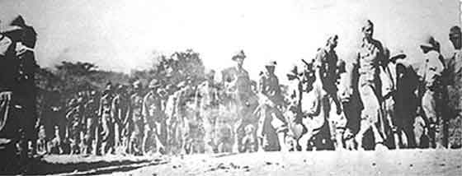
Coordinating Instructions

Slide 22
Coordinating Instructions
Remember the following:
  Key Intersections: Km #14; Km #23; Km #32 (Always Turn Right)
  @ Lubao, Pampanga: Runners follow the National Highway while Support Vehicles take the Detour
  @ Guagua, Pampanga: Km #92 is within the vicinity of RAZON’s Restaurant
  @BDM Km Post #102: Take the paved road at the sides of the Old Railway Station towards McArthur Highway
  @DPWH Km Post #118: Turn-around for BDM 160
  @Capas National Shrine Obelisk: Finish Line for BDM 160

Slide 23
Coordinating Instructions
3 Ambulances & Medical Teams
Emergency Contact Numbers:
  0918-910-0825
  0938-218-6437
In dark places, run in the company of other runner/s
In case of DNF, please report the following info:
  Km Point Where You Declared As DNF
  Cause of DNF

Slide 24
Review of BDM 102 Runs
Time To Beat: 10:01:05 hours (Overall/Men’s)
Time To Beat: 16:00:07 hours (Ladies)
2009 Results: 82/63 (77%)
2010 Results: 128/104 (81.25%)

Slide 25
GOOD LUCK & SEE YOU AT STARTING LINE!!!

